Slide 2
članovi:
Angus Young, Chris Slade, Stevie Young Axl Rose

Slide 3
Angus young
Angus McKinnon Young (born 31 March 1955) is a Scottish-Australian guitarist, best known as the co-founder, lead guitarist, songwriter and only remaining original member of the Australian hard rock band AC/DC.

Slide 4
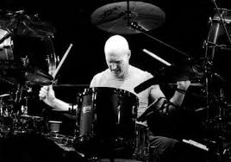
Chris slade
Chris Slade (born Christopher Rees; 30 October 1946) is a Welsh rock musician and drummer, best known for playing for the Australian hard rock band AC/DC.

Slide 5
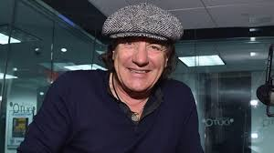
Steavie Young
Stephen Crawford Young (born 11 December 1956) is a Scottish musician, and the rhythm guitarist and backing vocalist for the Australian hard rock band, AC/DC. He officially joined the band in September 2014, replacing his uncle.

Slide 6
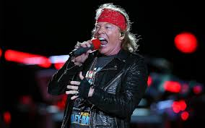
Axl Rose
W. Axl Rose (born William Bruce Rose Jr.; raised as William Bruce Bailey; born February 6, 1962)^{[3]} is an American singer, songwriter, record producer and musician. He is the lead vocalist of the hard rock band Guns N' Roses, and has also been the band's sole constant member since its inception in 1985.^{[4]} In addition to Guns N' Roses, he has been the lead singer of AC/DC since 2016.

Slide 7
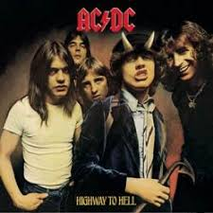
AC/DC zajedno

Slide 8
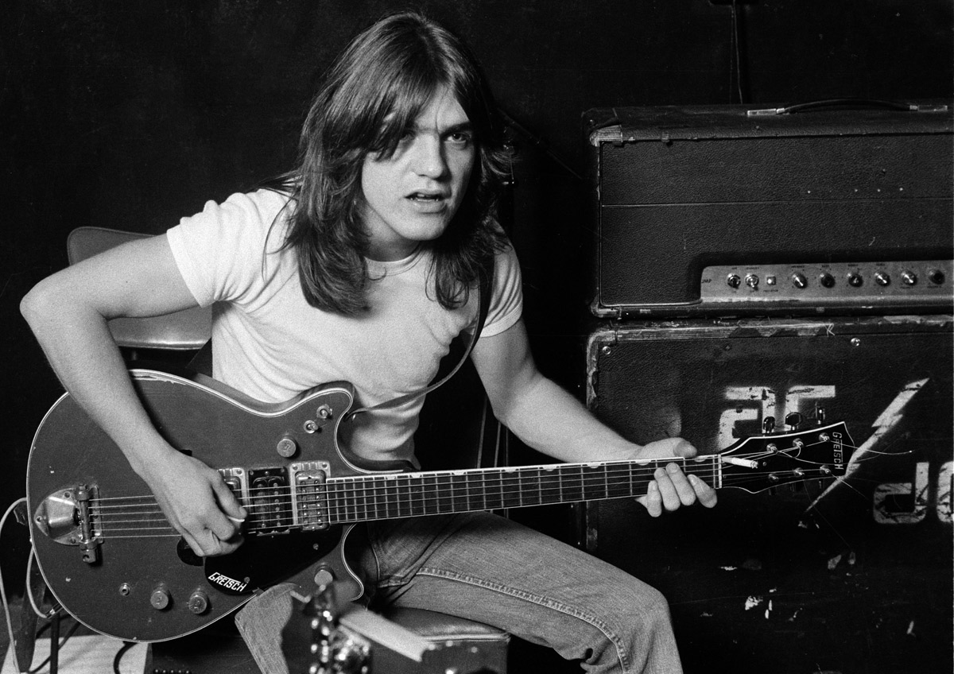
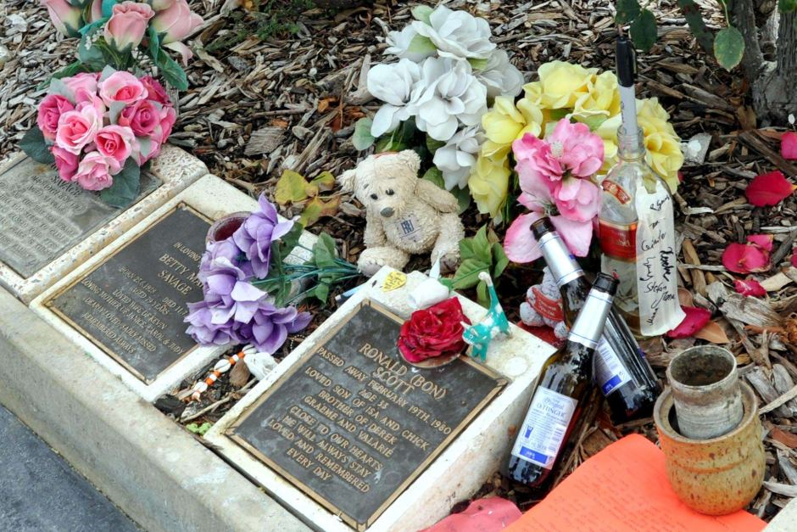
Malcom young
Malcolm Mitchell Young (6 January 1953 – 18 November 2017) was a Scottish-Australian musician and songwriter, best known as a co-founder, rhythm guitarist, backing vocalist and songwriter for the hard rock band AC/DC. umro je 18.11 2017.

Slide 9
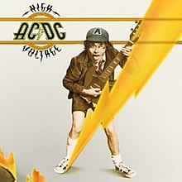
Prvi album
Prvi album je high voltage pjesme:
it's a long way to the top (if you wanna rock 'n' roll)
ac/dc rock 'n' roll singer
ac/dc the jack
ac/dc live wire
ac/dc t.n.t.
ac/dc can i sit next to you girl
ac/dc little lover
ac/dc she's got balls
ac/dc high voltage

Slide 10
član | Godina rođenja | Godina smrti | Instrument | Grad
Angus Young, | 31 march 1955 | ------------------------ | gitara | Škotska-Australija
Chris Slade | 30 october 1946 | ------------------------ | bubnjevi | Vejls
Stevie Young | 11 december 1956 | ------------------------ | Gitara i pjevač | Šlotska
Malcom young | 6 jenuary 1953 | 18 november 2017 | gitara | Škotska-Australija

